Slide 1
Mastering PowerShell Testing with Pester
Mark Wragg

Slide 2

About Me
Describing Speaker
[-] Error occurred in Describe block
Expected: 'The foremost expert in Pester'
But was: 'Mark Wragg’
Twitter : @markwragg
Website : http://wragg.io
GitHub : http://github.com/markwragg
DevOps Engineer, XE.com

Slide 3

About Pester
A PowerShell Module for testing PowerShell code
Pester is written in PowerShell
Pester is used to test PowerShell Core
Pester is used to test.. Pester
Install it via:
Install-Module Pester
On Windows 10 its pre-installed, but you can update it via:
Install-Module Pester -Force -SkipPublisherCheck

Slide 4
Testing Strategies
Pester is a versatile tool that can be used for a variety of testing strategies.
Operational Validation:
System / infrastructure is configured / working as expected
Integration Testing:
The end result of your code is correct / your code works with other modules.
Unit Testing:
A unit of code – does one thing

Slide 5
Why should you write tests?
Testing is the single most important thing you will ever do.
You are already testing your code, Pester allows that testing to be more detailed and thorough.
Testing is an essential prerequisite to continuous integration / continuous delivery (CICD). You need tests that are run automatically when your code changes.
Tests act as a form of documentation (but shouldn’t be exclusively so).

Slide 6

You are a developer.
Beware of imposter syndrome.
Developer
[dih-vel-uh-per]
noun
An organism capable of converting caffeine in to code.

Slide 7
PowerShell Code Maturity
Pester needs to be able to read your code and control when parts execute for it to be testable.
Console commands (one liners)
Basic scripts (one or more commands saved as a .ps1)
Scripts that include functions but that are executed within the same script.
Scripts that define only functions
Module with functions organised in individual files
Module automatically tested and published via a CICD Pipeline
Module with functions all declared as a single .psm1 file
Module with manifest, published in the PowerShell Gallery
Not testable
Testable

Slide 8
Getting Started
A Pester script is just a PowerShell script with some additional keywords and structure.
Describe
Context
It
Should
Mock

Slide 9
A simple example
function Add-One ([int]$Number) {
$Number + 1
}
Describe 'Add-One tests' {
It 'Should add one to a number' {
Add-One 1 | Should -Be 2
}
It 'Should add one to a negative number' {
Add-One -1 | Should -Be 0
}
}

Slide 10
A more realistic example
function Remove-TempFile ($Path) {
$TempFiles = Get-ChildItem "$Path/*.tmp"
$TempFiles | Remove-Item
}
Describe 'Remove-TempFile tests’ {
$TestFile = New-Item /tmp/test.tmp
It 'Should return nothing' {
Remove-TempFile -Path /tmp | Should -Be $null
}
It 'Should remove the test file’ {
$TestFile | Should -Not -Exist
}
It 'Should not return an error' {
{ Remove-TempFile -Path /tmp } | Should -Not -Throw
}
}
This is also an example of the Arrange - Act - Assert testing pattern.

Slide 11
Refactoring
Refactoring is the process of changing code without changing its behaviour.
Breaking your code in to smaller pieces (functions) so that each does just one thing.
Unit tests are about proving correctness.
A Unit of code should do only one thing.
A Unit test allows you to prove it does that one thing correctly.
Notes:
Prove Contract – Test it accept/rejects valid/invalid inputs
Prove Results – Test it performs the data reduction (e.g takes two input values and returns one), transformation or state change (connect/disconnect API etc.) you expected.
Prove Error Handling – Test that it correctly handles external exceptions (e.g when a service it is interacting with throws an error or is unavailable).

Slide 12
A refactored example
function Get-TempFile ($Path) {
Get-ChildItem "$Path/*tmp*"
}
function Remove-TempFile ($Path) {
$TempFiles = Get-TempFile -Path $Path
$TempFiles | Remove-Item
}
Describe 'Get-TempFile tests' {
New-Item TestDrive:/test.tmp
New-Item TestDrive:/tmp.doc
It 'Should return only .tmp files' {
(Get-TempFile -Path TestDrive:/).Extension | Should -Be '.tmp'
}
}

Slide 13
About TestDrive
TestDrive is a PSDrive for file activity limited to the scope of a Describe or Context block.
Creates a randomly named folder under $env:temp which you can then reference via TestDrive: or $TestDrive
$TestDrive is the full literal path (useful if you need to do path comparisons).
Use this as a safe space in which to do file operations, that is cleaned up automatically for you.
Pester will keep a record of the files present in the location before entering a Context block and will remove any files therefore created by the Context block, but won’t revert files that have been modified.

Slide 14
Mocking
Mocking is a facet of unit testing that involves replacing real cmdlets or functions with simulated ones.
This can be useful for a number of reasons:
Your code relies on missing external resources.
Your code makes destructive or other permanent or undesirable changes.
The code you are testing is using some secondary function that already has its own set of tests.

Slide 15
A mocking example
Describe 'Remove-TempFile tests' {
Mock Remove-Item { }
New-Item TestDrive:/test.tmp
New-Item TestDrive:/tmp.doc
$TestResult = Remove-TempFile -Path TestDrive:\
It 'Should return nothing' {
$TestResult | Should -Be $null
}
It 'Should call Remove-Item' {
Assert-MockCalled Remove-Item -Times 1 -Exactly
}
}

Slide 16
Mocking cmdlets that aren’t present
Pester needs the cmdlet or function you are mocking to exist on the current system, but you can fake it if it doesn’t.
If you attempt to Mock a cmdlet that isn’t currently available (e.g in a module not installed on your system) Pester will throw an error.
You can work around this by declaring a fake function in its place.
You can then still also declare a Mock, so that you can use Assert-MockCalled.
This can get complex, so use only when needed. If you can make the required cmdlets/functions available that is more ideal.

Slide 17
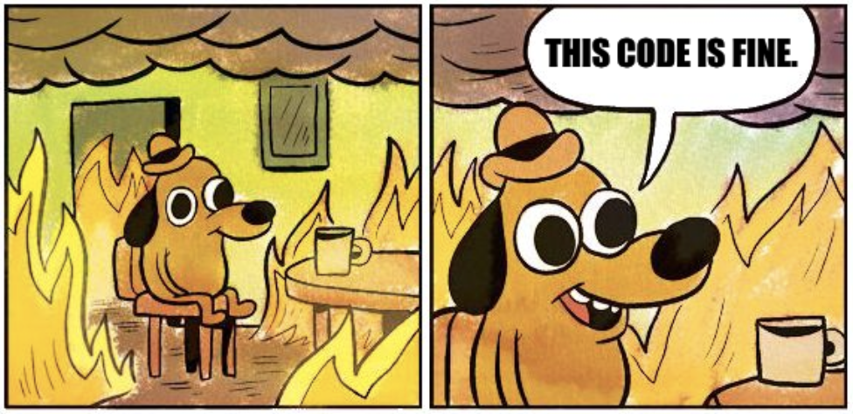
Code Coverage
Code coverage is a measure that indicates how much of your code was executed when your tests ran.
Code Coverage is a useful measure of how thorough your tests are.
100% code coverage does not equal 100% working code.
Getting close to 100% is good, but achieving 100% code coverage isn’t always useful.

Slide 18
Why is code coverage reporting useful?
Your code likely has multiple happy (successful) and unhappy (fail, error, exception) paths.
If your code contains any logical statements (if, switch, try..catch etc.) then there are multiple ways in which it can be executed to either a successful or unsuccessful conclusion.
The code coverage report helps to highlight which of these paths have not been taken.

Slide 19
How to use the code coverage feature of Pester
The Pester code coverage feature requires PowerShell version 3.0 or greater.
To check code coverage, you need to execute pester with the –CodeCoverage parameter and send it a list of code files that you are evaluating:
Invoke-Pester -CodeCoverage (Get-Childitem .\YourModule\*.ps1 -Recurse)

Slide 20
Summary
Writing, maintaining and executing tests is an essential and accessible PowerShell skill.
Pester is just PowerShell with a few extra commands to learn.
There is an excellent and detailed Wiki on the official Pester repository that explains all the concepts:
https://github.com/pester/Pester/wiki
There are lots of people in the community ready and willing to help you:
The #Pester tag on StackOverflow.com.
PowerShell.org forums.
r/PowerShell
The PowerShell Slack community.

Slide 21
Any questions?
Twitter : @markwragg
Website : http://wragg.io
GitHub : https://github.com/markwragg

Slide 22
Twitter : @markwragg
Website : http://wragg.io
GitHub : https://github.com/markwragg

